Slide 1

CHAPTER 10
THEORY OF GRAPHS AND TREES
Copyright © Cengage Learning. All rights reserved.

Slide 2

10.2
Matrix Representations of Graphs
Copyright © Cengage Learning. All rights reserved.

Slide 3
Matrices

Slide 4
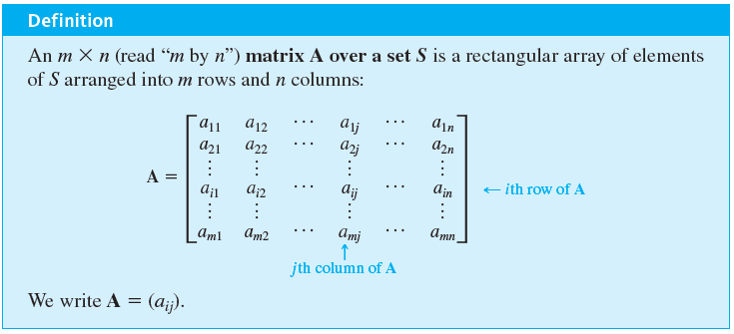
Matrices
Matrices are two-dimensional analogues of sequences. They are also called two-dimensional arrays.

Slide 5

Matrices
The i th row of A is
[a _{i 1} a _{i 2} … a _{in}]
and the j th column of A is

Slide 6
Matrices
The entry a _{i j} in the i th row and j th column of A is called the i j th entry of A. An
matrix is said to have size
If A and B are matrices, then A = B if, and only if, A and B have the same size and the corresponding entries of A and B are all equal; that is,
a _{ij} = b _{ij} for every i = 1, 2, . . . , m and j = 1, 2, . . . , n.

Slide 7
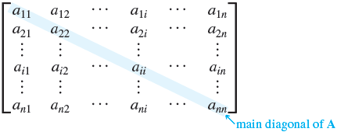
Matrices
A matrix for which the numbers of rows and columns are equal is called a square matrix.
If A is a square matrix of size
then the main diagonal of A consists of all the entries a₁₁, a₂₂, . . . , a _{nn}:

Slide 8

Example 10.2.1 – Matrix Terminology
The following is a
matrix over the set of integers.
a. What is a₂₃, the entry in row 2, column 3?
b. What is the second column of A?
c. What are the entries in the main diagonal of A?

Slide 9


Example 10.2.1 – Solution

Slide 10
Matrices and Directed Graphs

Slide 11
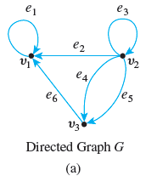
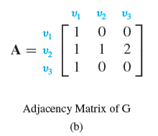
Matrices and Directed Graphs
Consider the directed graph shown in Figure 10.2.1. This graph can be represented by the matrix A = (a _{ij}) for which a _{ij} = the number of arrows from v_{i} to v_{j}, for every i = 1, 2, 3 and j = 1, 2, 3.
A Directed Graph and Its Adjacency Matrix
Figure 10.2.1

Slide 12
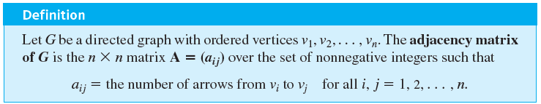
Matrices and Directed Graphs
Thus a₁₁ = 1 because there is one arrow from v₁ to v₁; a₁₂ = 0 because there is no arrow from v₁ to v₂, a₂₃ = 2 because there are two arrows from v₂ to v₃, and so forth. A is called the adjacency matrix of the directed graph. For convenient reference, the rows and columns of A are often labeled with the vertices of the graph G.

Slide 13
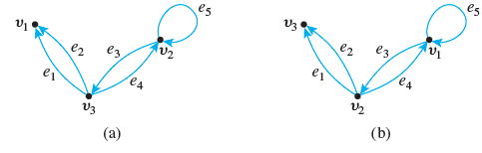
Example 10.2.2 – The Adjacency Matrix of a Graph
The two directed graphs shown below differ only in the ordering of their vertices.
Find their adjacency matrices.

Slide 14
Example 10.2.2 – Solution
Since both graphs have three vertices, both adjacency matrices are
matrices.
For (a), all entries in the first row are 0 since there are no arrows from v₁ to any other vertex.
For (b), the first two entries in the first row are 1 and the third entry is 0 since from v₁ there are single arrows to v₁ and to v₂ and no arrows to v₃.

Slide 15
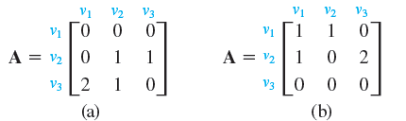
Example 10.2.2 – Solution
continued
Continuing the analysis in this way, you obtain the following two adjacency matrices:

Slide 16
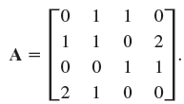
Example 10.2.3 – Obtaining a Directed Graph from a Matrix
Let
Draw a directed graph that has A as its adjacency matrix.

Slide 17
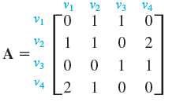
Example 10.2.3 – Solution
Let G be the graph corresponding to A, and let v₁, v₂, v₃, and v₄ be the vertices of G. Label A across the top and down the left side with these vertex names, as shown below.

Slide 18
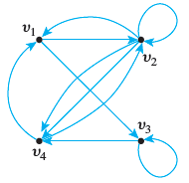
Example 10.2.3 – Solution
continued
Then, for instance, the 2 in the fourth row and the first column means that there are two arrows from v₄ to v₁. The 0 in the first row and the fourth column means that there is no arrow from v₁ to v₄. A corresponding directed graph is shown here (without edge labels because the matrix does not determine those).

Slide 19
Matrices and Undirected Graphs

Slide 20
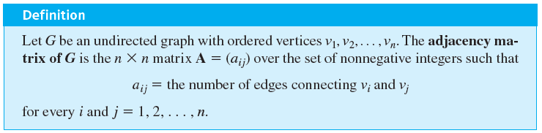
Matrices and Undirected Graphs
Once you know how to associate a matrix with a directed graph, the definition of the matrix corresponding to an undirected graph should seem natural to you. As before, you must order the vertices of the graph, but in this case you simply set the i j th entry of the adjacency matrix equal to the number of edges connecting the i th and j th vertices of the graph.

Slide 21
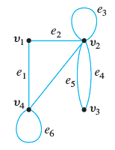
Example 10.2.4 – Finding the Adjacency Matrix of a Graph
Find the adjacency matrix for the graph G shown below.

Slide 22
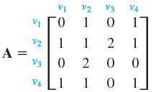
Example 10.2.4 – Solution

Slide 23
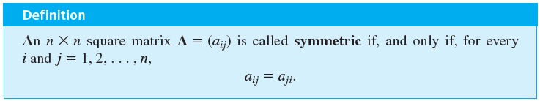
Matrices and Undirected Graphs
The entries of A satisfy the condition, a _{ij} = a _{ji}, for every i,
j = 1, 2, . . . , n. This implies that the appearance of A remains the same if the entries of A are flipped across its main diagonal. A matrix, like A, with this property is said to be symmetric.

Slide 24



Example 10.2.5 – Symmetric Matrices
Which of the following matrices are symmetric?

Slide 25
Example 10.2.5 – Solution
Only (b) is symmetric.
In (a) the entry in the first row and the second column differs from the entry in the second row and the first column; the matrix in (c) is not even square.

Slide 26
Matrices and Connected Components

Slide 27
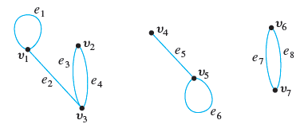
Matrices and Connected Components
Consider a graph G, as shown below, that consists of several connected components.

Slide 28
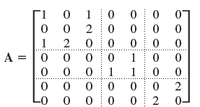
Matrices and Connected Components
The adjacency matrix of G is

Slide 29
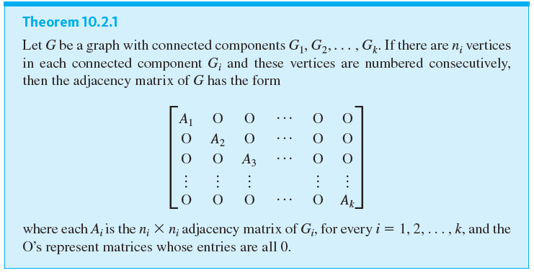
Matrices and Connected Components

Slide 30
Matrix Multiplication

Slide 31
Matrix Multiplication
Matrix multiplication is an enormously useful operation that arises in many contexts, including the investigation of walks in graphs.
Although matrix multiplication can be defined in quite abstract settings, the definition for matrices whose entries are real numbers will be sufficient for our applications.

Slide 32
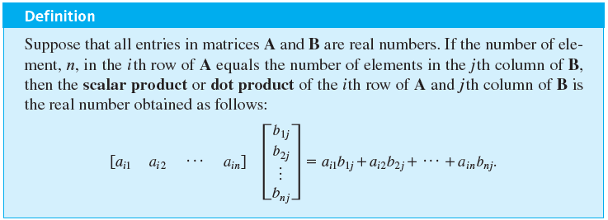
Matrix Multiplication
The product of two matrices is built up of scalar or dot products of their individual rows and columns.

Slide 33
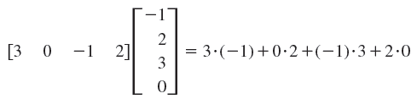
Example 10.2.6 – Multiplying a Row and a Column

Slide 34
Matrix Multiplication
More generally, if A and B are matrices whose entries are real numbers and if A and B have compatible sizes in the sense that the number of columns of A equals the number of rows of B, then the product AB is defined.
It is the matrix whose i j th entry is the scalar product of the i th row of A times the j th column of B, for all possible values of i and j.

Slide 35
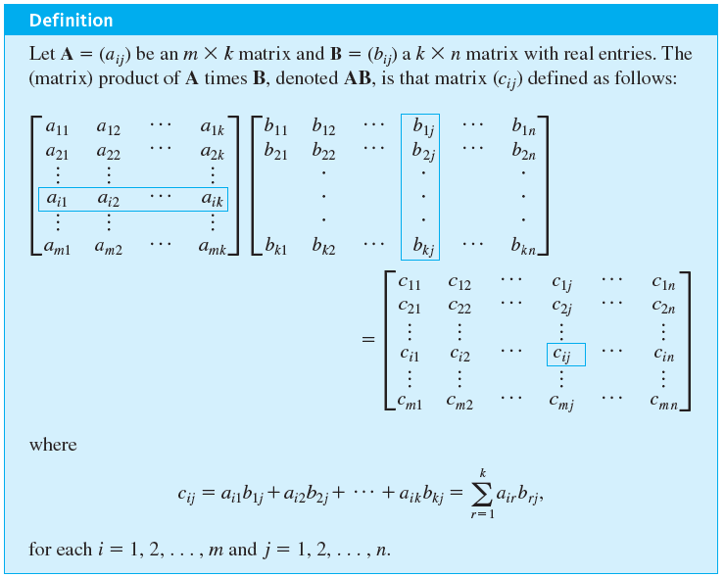
Matrix Multiplication

Slide 36

Example 10.2.7 – Computing a Matrix Product

Slide 37



Example 10.2.7 – Solution
A has size
and B has size
so the number of columns of A equals the number of rows of B and the matrix product of A and B can be computed. Then
where

Slide 38



Example 10.2.7 – Solution
continued

Slide 39

Example 10.2.7 – Solution
continued
Hence

Slide 40
Matrix Multiplication
Matrix multiplication is both similar to and different from multiplication of real numbers. One difference is that although the product of any two numbers can be formed, only matrices with compatible sizes can be multiplied. For example, if A is a
matrix and B is a
matrix, then AB can be computed because the number of columns of A equals the number of rows of B.
But BA does not exist because B has 4 columns, A has 3 rows, and 4 ≠ 3.

Slide 41

Matrix Multiplication
Another difference is that multiplication of real numbers is commutative (for all real numbers a and b, ab = ba), whereas matrix multiplication is not. For instance,
On the other hand, both real number and matrix multiplications are associative: (ab)c = a(bc), for all elements a, b, and c for which the products are defined.

Slide 42
Matrix Multiplication
As far as multiplicative identities are concerned, there are both similarities and differences between real numbers and matrices. You know that the number 1 acts as a multiplicative identity for products of real numbers.
It turns out that there are certain matrices, called identity matrices, that act as multiplicative identities for certain matrix products.

Slide 43
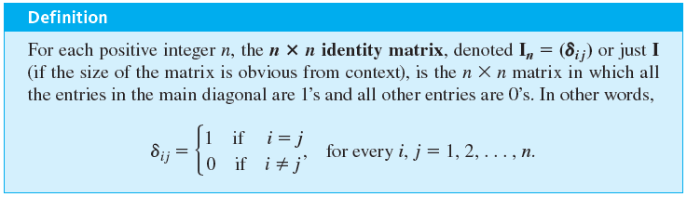
Matrix Multiplication

Slide 44
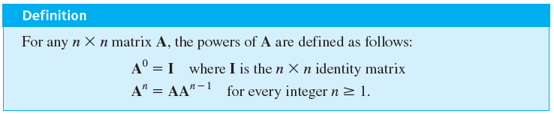
Matrix Multiplication
There are also similarities and differences between real numbers and matrices with respect to the computation of powers. Any number can be raised to a nonnegative integer power, but a matrix can be multiplied by itself only if it has the same number of rows as columns.

Slide 45

Example 10.2.10 – Powers of a Matrix

Slide 46



Example 10.2.10 – Solution

Slide 47
Counting Walks of Length N

Slide 48
Counting Walks of Length N
A walk in a graph consists of an alternating sequence of vertices and edges. If repeated edges are counted each time they occur, then the number of edges in the sequence is called the length of the walk. For instance, the walk v₂e₃v₃e₄v₂e₂v₂e₃v₃ has length 4 (counting e₃ twice). Consider the following graph G:

Slide 49
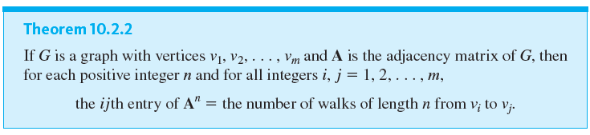
Counting Walks of Length N
If A is the adjacency matrix of a graph G, the i j th entry of
equals the number of walks of length 2 connecting the i th vertex to the j th vertex of G. Even more generally, if n is any positive integer, the i j th entry of
equals the number of walks of length n connecting the ith and the j th vertices of G.

